Slide 1










Python in Fabric for Data Engineers
Arthur Graus

Slide 2



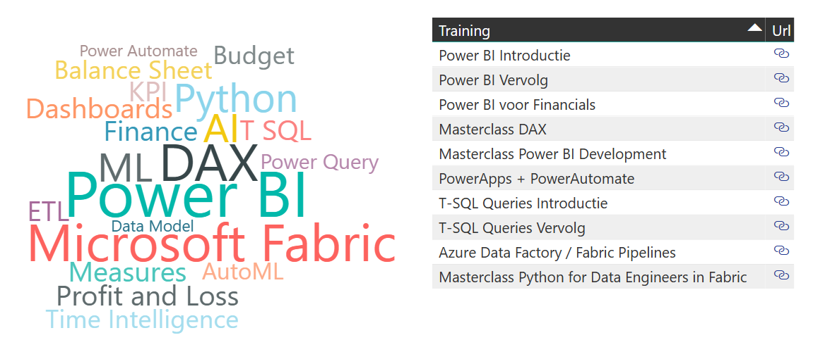

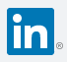
Bio: Arthur Graus
Power BI + MS Fabric Trainer | Developer / ML Enthusiast
https://www.arthurgraus.nl/training.html
Questions, re
info@arthurgraus.nl
https://www.linkedin.com/in/arthurgraus

Slide 3
Table of Contents
Overview
Use cases
Modules overview
Installation
Syntax + Expressions
Syntax
String Expressions
Number Expressions
DateTime Expressions
Logical Expressions
List Expressions
Loops
Dictionary Expressions
Modular programming
Functions
Pip package manager
Modules, Packages
Jupyter Notebooks + Markdown
Data Wranging with Pandas
Pandas Data Frames / NumPy Arrays / Vectorized Operations
Import files: CSV, Excel + Parquet
Transforming Data: Filter, Group By, Select, Join
Lakehouse / Apache Spark
Data Warehouse, Data Lake, Lakehouse / Fabric
Spark overview: architecture , RDD, Dataframe
Import files: Parquet files
Transforming Data: Filter, Group By, Select
Import from SQL Server
Save to Lakehouse: Files + Tables
Delta Lake
CRUD operations
Bonus: Calling REST API's
REST API's + HTTP
Request
Response

Slide 4
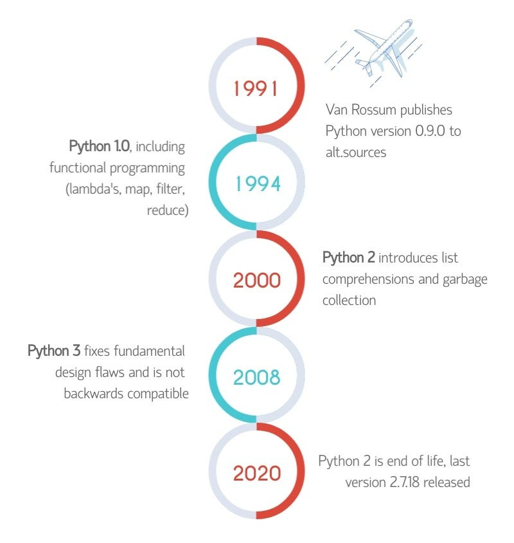

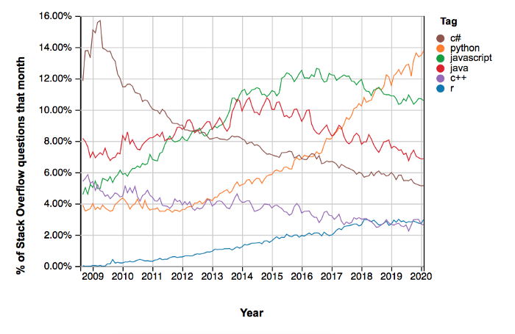


History
https://en.wikipedia.org/wiki/History_of_Python

Slide 5







Python Use Cases:
Web Development
Django
Game Development:
PyGame
Web Scraping
Beautifulsoup
Scientific and Numeric Computing
NumPy, SciPy
Data Analysis
Pandas, Mathplotlib, Seaborn
Data Science
Pandas, SciPy, Scikit-Learn, Tensorflow, Keras
Data Engineering
Pandas, SQLAchemy, PySpark, Requests/Response

Slide 6
Getting started
1. Install Anaconda
Go to https://www.anaconda.com/download to download the Anaconda installer, for windows you download the .exe file and for Mac download the .pkg file.
2. Install Visual Studio Code
Go to https://code.visualstudio.com/download and download Windows or IOS installer
Python extension for Visual Studio Code https://marketplace.visualstudio.com/items?itemName=ms-python.python
Jupyter Extension for Visual Studio Code https://marketplace.visualstudio.com/items?itemName=ms-toolsai.jupyter

Slide 7
Syntax + Expressions

Slide 8
String Expressions
firstName = "John"
lastName = 'Doe'
fullName = firstName + " " + lastName # "John Doe"
print( firstName.upper() ) # "JOHN"
print( firstName.lower() ) # "john"
print( firstName[0] ) # J
print( firstName[1:3] ) # oh
length = len(firstName) # 4
print( "It's raining" ) # It's raining
print( 'It\'s raining' ) # It's raining
# raw-strings
print( "c:\\data\\input" ) # c:\data\input
print(r"c:\data\input" ) # c:\data\input
# f-strings
print( fr"xtreme\{firstName.lower()}" ) # Xtreme\john
message = f"Hello {firstName},\n\tHave a good day!" # Hello John,
messageMultiLine = f"""Hello {firstName}, # Have a good day!
Have a good day!
"""

Slide 9
Number Expressions
import math
#Number Types
varInt = 1 # int
varFloat = 2.8 # float
varUnitPrice = 12.55
varQuantity = 5
varLineTotal = varQuantity * varUnitPrice # 62.75
varRound = round(varLineTotal,0) # 63
varRoundDown = math.floor (varLineTotal) # 62
varRoundUp = math.ceil(varLineTotal) # 63
varModulo = varRoundUp % 2 # 1
varFloorDivide = varRoundDown // 2 # 31
Operator | Description
+ | Add
- | Substract
* | Multiply
/ | Division
// | Floor division
% | Module, remainder of a division

Slide 10
Number Formatting
import decimal
import locale
# Parsing / Localization
locale.setlocale(locale.LC_ALL, 'nl-NL')
varDecimalStr = input('Enter in decimal nr:') # 1.234,567
varDecimal = locale.atof(varDecimalStr, decimal.Decimal)
#Formatting
# Python 3.6+ f-strings
varFormat =f"€ { varDecimal :.2f}" # € 1234.57
varFormat =f"€ { varDecimal :.0f}" # € 1235
varFormat =f"€ { varDecimal :,.0f}" # € 1,235
varFormat =f"{ 9 :0>2d}" # 09
varFormat =f"{ 0.35 :.0%}" # 35%

Slide 11
DateTime Expressions
from datetime import date, datetime, timedelta
from dateutil.relativedelta import relativedelta
# DateTime: varNow = datetime.now() # 2023-03-15 12:34:22.231975
# Date: varToday = date.today() # 2023-03-15
varYear = varToday.year # 2023
varMonth = varToday.month # 3
varquarter = (varMonth - 1) // 3 + 1 # 1
varYesterday = varToday - timedelta( days=1) # 14-03-2023
varPrevMonth = varToday - relativedelta( months=1) # 15-02-2023
varStartYear = date(varYear, 1, 1) # 01-01-2023
varBirthDate = date(1974, 9, 2) # 02-09-1974
# Duration: varDuration = (varToday - varBirthDate).days # 17717

Slide 12
DateTime Formatting
#Parse string
varDateStr = input('Enter a date') # 15-03-2023
varDate = datetime.strptime(varDateStr, "%d-%m-%Y")\ .date() # 2023-03-15
#Format string
frmt = varDate.strftime("%d-%m-%Y") # 15-03-2023
frmt = varDate.strftime("%m/%d/%y") # 03/15/23
frmt = varDate.strftime("%d %b %Y") # 15 Mar 2023
frmt = varDate.strftime("%A") # Wednesday
frmt = varNow.strftime("%H:%M" ) # 12:34
Date Time Formatting Options
%a Weekday, short version
%A Weekday, full version
%w Weekday as a number 0-6, 0 is Sunday
%d Day of month 01-31
%b Month name, short version
%B Month name, full version
%m Month as a number 01-12
%y Year, short version, without century
%Y Year, full version
%H Hour 00-23
%I Hour 00-12
%p AM/PM
%M Minute 00-59 41
%S Second 00-59 08
%f Microsecond 000000-999999 548513
%z UTC offset +0100
%Z Timezone CST
%j Day number of year 001-366 365
%U Week number of year, starts at Sunday
%W Week number of year, starts at Monday
%G ISO 8601 year 2018
%u ISO 8601 weekday (1-7) 1
%V ISO 8601 weeknumber (01-53) 01

Slide 13
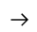
Logical Expressions
Operator | Description
== | Equal
> , < | Greater than, less than
>= , <= | Greater or equal, less or equal
!= | Not equal
not | Not
or | Or
and | And
is None | Is empty / null
varUnitPrice = 120.55 varQuantity = 5 varLineTotal = varQuantity * varUnitPrice # 602.75
# Indentation is required!
if varLineTotal < 100 or varQuantity == 1 : varOrderLineSize = "Small"
elif varLineTotal >= 100 and varLineTotal < 500 : varOrderLineSize = "Medium"
elif varLineTotal >= 500 and varLineTotal < 1000 : varOrderLineSize = "Large"
else: varOrderLineSize = "Extra Large"
print(varOrderLineSize) # "Large"
# Inline if (ternary conditional operator)
x = 10 y = "Even" if x % 2 == 0 else "Odd" print(y) # Output: "Even"

Slide 14
List Expressions
# List:
# Index 0 1 2 3 4 5 6
mylist = ["apple", "banana", "cherry", "orange", "kiwi", "melon", "mango"]
print(len(mylist)) # 7
print(mylist[0]) # "apple"
print(mylist[1]) # "banana"
print(mylist[-1]) # "mango"
print(mylist[2:5]) # Index:2,3,4 = ["cherry", "orange", "kiwi"]
print(mylist[:3]) # Index:0,1,2 = ["apple", "banana", "cherry"]
print(mylist[4:]) # Index:4,5,6 = ["kiwi", "melon", "mango"]
# Insert mylist.insert(2, "watermelon") # ["apple", "banana", "watermelon" ...]
mylist.append("lemon")
# Remove mylist.pop(2)

Slide 15
Loops
mylist = ["apple", "banana", "cherry", "orange", "kiwi", "melon", "mango"]
# for each
for item in mylist :
print(item)
# for
for i in range(len(mylist)):
print(mylist[i])
# while loop
i = 0
while i < len(mylist):
print(mylist[i])
i = i + 1

Slide 16
Dictionary Expressions
thisdict = {
"brand": "Ford",
"model": "Mustang",
"year": 1964
}
listOfDictionaries =[
{
"brand": "Ford",
"model": "Mustang",
"year": 1964
} ,
{
"brand": "Mercedes",
"model": "CL300",
"year": 1955
}
]
for car in listOfDictionaries :
print(car["brand"])

Slide 17
Modular Programming

Slide 18
Functions
# Define Function, Type hints are optional: def fullname(firstName :str, lastName :str) ->str: return firstName + ' ' + lastName
fName = "John" lName = 'Doe'
# Call function: print( fullname(fName, lName))
# Call function with named parameters: print( fullname(firstName= fName,lastName= lName) )

Slide 19
Modules
Modules are .py files that contain Variables, Functions and Classes
You can import a module using the import statement:
import datetime varToday = datetime.date.today()
import datetime as dt varToday = dt.date.today()
from datetime import date, datetime, timedelta varToday = date.today()

Slide 20
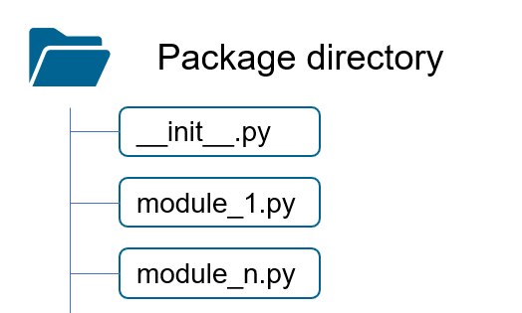
Packages
A package is a collection of Sub- packages and Modules:
Contains an __init__.py file in the root folder
Package . Module Class from dateutil.relativedelta import relativedelta varPrevMonth = varToday - relativedelta( months=1)

Slide 21

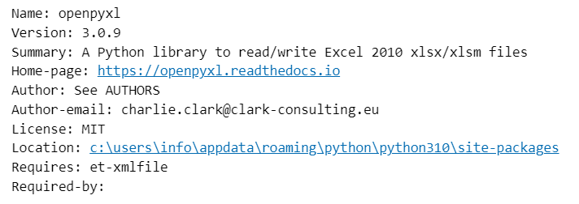
Pip: Python Package Manager
# list packages ! pip list
# install package ! pip install openpyxl
# install package with specific version ! pip install openpyxl==3.0.9
# details package ! pip show openpyxl
# upgrade package ! pip install --upgrade openpyxl ! pip show openpyxl
# install multiple packages ! pip install openpyxl numpy
# install multiple packages with requirements file # https://note.nkmk.me/en/python-pip-install-requirements/
# Uninstall package ! pip uninstall openpyxl
# Check for missing or invalid dependencies ! pip check
PyPI: https://pypi.org

Slide 22
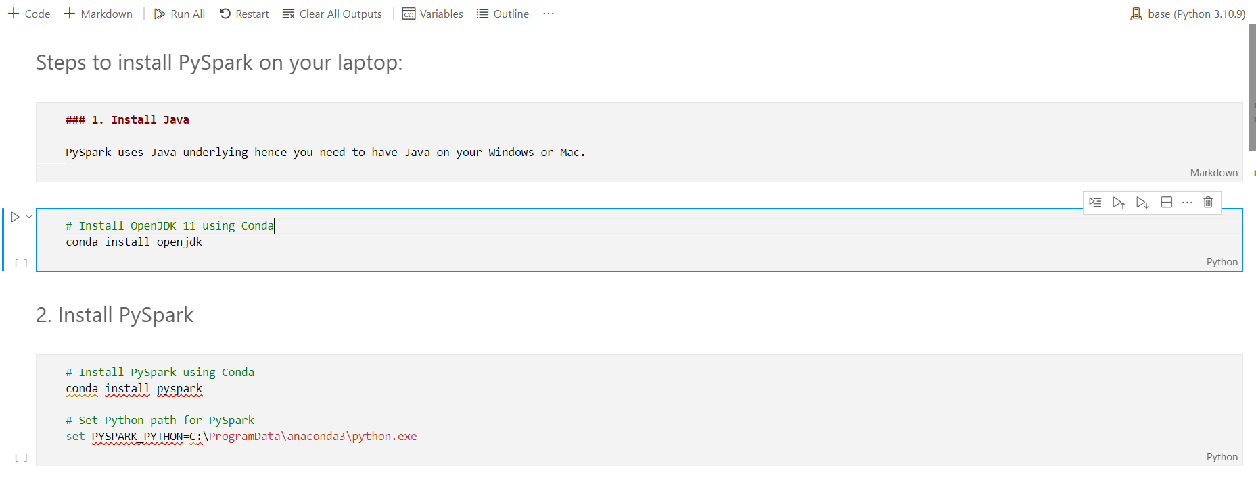
Jupyter Notebook == JSON file with .ipynb extension
Jupyter, an evolution of IPython, is named after Galileo's notebooks on discovering Jupiter's moons and the core languages: Julia, Python and R
Markdown
Markdown
Code
Cells
Markdown
Code

Slide 23
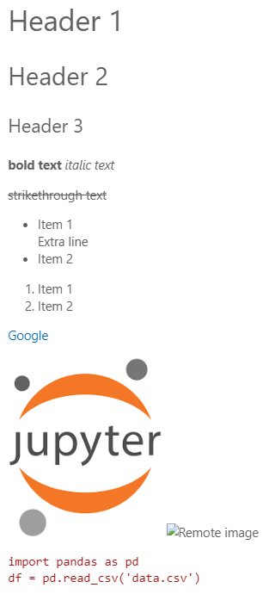
Jupyter Notebook: Markdown
# Header 1 ## Header 2 ### Header 3 **bold text** *italic text* ~~strikethrough text~~ <!-- 2 enters == Hard Line Break --> <!-- 2 spaces at the end == Soft Line Break --> - Item 1.. ..Extra line<!-- 2 spaces before == Tab --> - Item 2 1. Item 1 2. Item 2 <!-- Hyperlinks --> [Google](https://www.google.com) <!-- Images --> ![Local image](../Images/Jupyter.png) ![Remote image](https://www.example.com/image.jpg) <!-- Code block --> import pandas as pd df = pd.read_csv('data.csv')

Slide 24
Data Wrangling with Pandas

Slide 25
NumPy
NumPy is a Python library used for working with arrays. It also has functions for working in the domain of linear algebra, fourier transform and matrices.
It was created in 2005 by Travis Oliphant as an open source project.
NumPy array object is up to 50x faster than traditional Lists.
!pip install pandas
import numpy as np
var1DArray = np.array( [1, 2, 3, 4, 5] )
print('2nd element: ', var1DArray[1]) # 2
var2DArray = np.array( [ [1, 2, 3], [4, 5, 6] ] )
print('3th element on 1st row: ', var2DArray[0, 2]) # 3

Slide 26
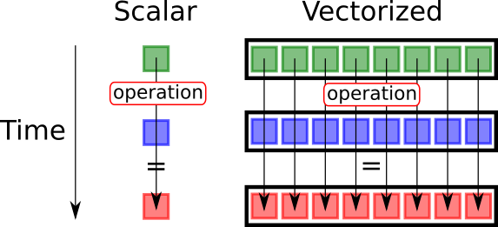
NumPy Vectorized Operations
array1 = np.array( [1, 2, 3, 4, 5] ) array2 = np.array( [2, 1, 4, 2, 1] )
# Non-vectorized - slow multiplyScalar = [x * 2 for x in array1]
# Vectorized - very fast multiplyScalar = array1 * 2 multiplyArrays = array1 * array2 addArrays = array1 + array2 subArrays = array1 - array2 # Error: most functions only work for scalar values divideArrays = round( array1 / array2, 1)
# Correct: np.round supports Vectorized Operations divideArrays = np.round(array1 / array2,1)
1
+
2
=
3
1
2
3
2
+
1
=
3
2
1
3
3
+
4
=
7
3
+
4
=
7
4
+
2
=
6
4
2
6
5
+
1
=
6
5
1
6
5 operations
1 operation

Slide 27
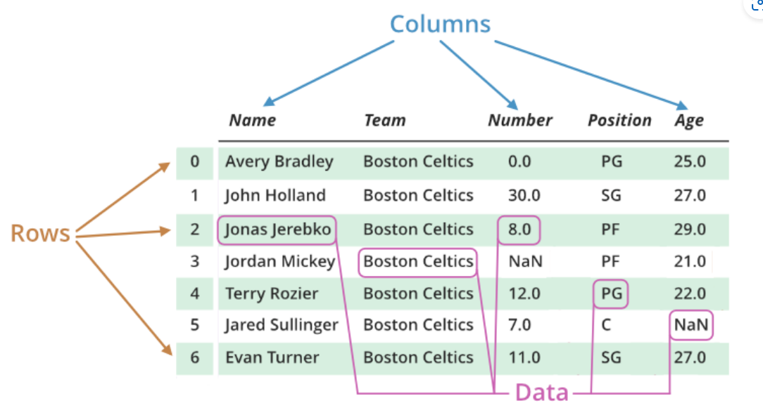
Pandas
Pandas is a Python library built on top of NumPy for data manipulation and analysis, providing data structures (DataFrame + Series) and tools to clean, transform, and aggregate structured data.
Series: 1 dimensional NumPy array == Dataframe Column
Pandas Dataframe:

Slide 28
Pandas DataFrame Basics 1/2
!pip install pandas
import pandas as pd from datetime import date, datetime, timedelta
# Series == Array of elements/items series = pd.Series([1001, 1002, 1003, 1004, 1005])
# Dataframe == Dictionary + Series df = pd.DataFrame( { 'OrderID': [1001, 1002, 1003, 1004, 1005], 'CustomerID': [5, 3, 2, 4, 6], 'OrderDate': [date(2023,3,2), date(2023,3,15), ...], 'ShipDate': [date(2023,3,6), date(2023,3,16), ...], 'CustomerName': ['John', 'Mike','Jane', 'Tom', 'Angela'], 'ProductID': [101, 202, 203, 404, 606], 'Qty': [1, 2, 1, 4, 10], 'Price': [2.15, 2.59, 4.08, 1.55, 3.54] } )
# Convert the Date columns to datetime data type df['OrderDate'] = df['OrderDate'].astype('datetime64') df['ShipDate'] = df['OrderDate'].astype('datetime64') df.info()
Pandas Data Types (astype):
Numeric Types int64 - Integers float64 - Floating points Boolean Type bool - True/False values
Date Time Types datetime64 - Date and time values timedelta – Diff. between two dates
Categorical Types category - Finite list of text values
Object Type object - Text or mixed values

Slide 29
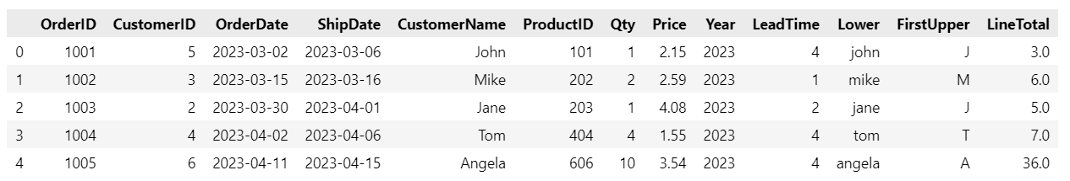
Pandas DataFrame Basics 2/2
# Column == Series seriesQty = dataframe['Qty'] seriesPrice = dataframe['Price'] # Use Vectorized Operations to create Calculated Columns seriesLineTotal = dataframe['Qty'] * dataframe['Price'] dataframe['LineTotal'] = dataframe['Qty'] * dataframe['Price']
# NumPy functions: dataframe['LineTotal'] = math.ceil(dataframe['Qty'] * dataframe['Price']) #only scalar values! dataframe['LineTotal'] = np.ceil(dataframe['Qty'] * dataframe['Price'])
# DateTime accessor: dataframe['Year'] = dataframe['OrderDate'].year # series has no year property! dataframe['Year'] = dataframe['OrderDate'].dt.year dataframe['LeadTime'] = ( dataframe['ShipDate'] - dataframe['OrderDate'] ).dt.days
# String accessor: dataframe['Lower'] = dataframe['CustomerName'].str.lower() dataframe['FirstUpper'] = dataframe['CustomerName'].str[0].str.upper()

Slide 30
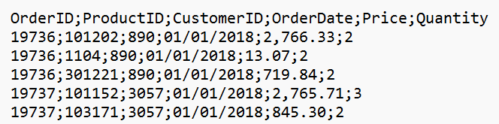
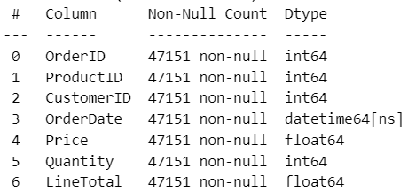
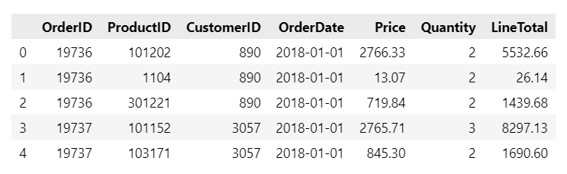
Pandas Import local CSV Files
import pandas as pd
import os
path = os.getcwd()
# load csv file into DataFrame dfOrders = pd.read_csv( fr'{path}\..\..\Data\Orders.csv', sep=';')
# Convert Text to DateTime, Numeric dfOrders['OrderDate'] = pd.to_datetime( dfOrders['OrderDate'], format='%m/%d/%Y' ) dfOrders['Price'] = pd.to_numeric( dfOrders['Price'].str.replace(',', '') ) # Calculated Columns dfOrders['LineTotal'] = dfOrders['Quantity'] * dfOrders['Price']
dfOrders.info() display(dfOrders.head(5))

Slide 31
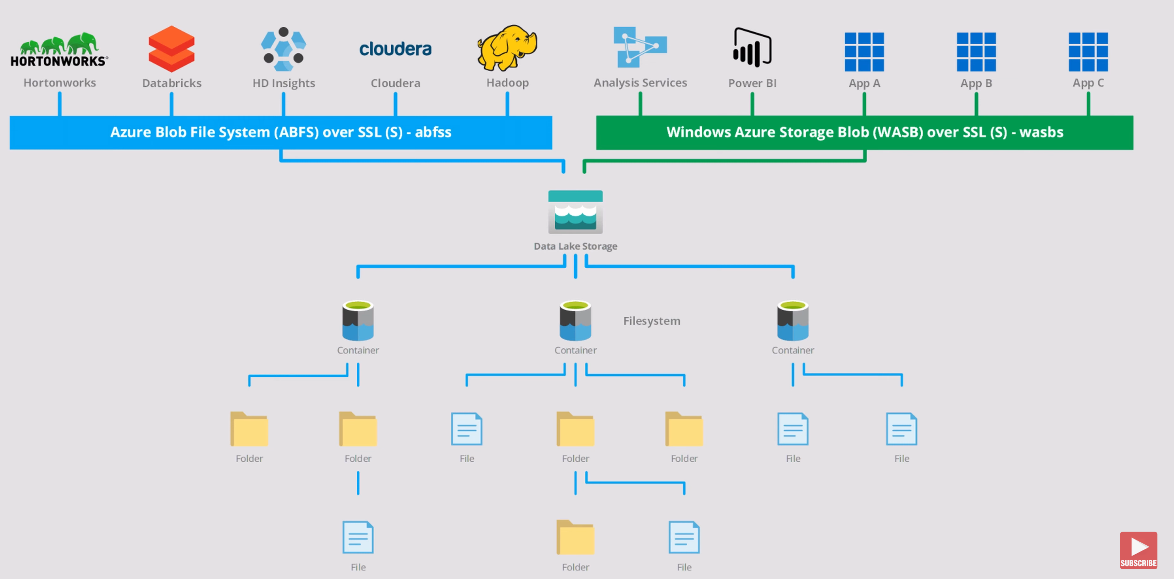


Azure Data Lake Storage Gen2

Slide 32

Pandas Import CSV File from ADLS Gen 2
!pip install adlfs
import pandas as pd
storage_options={ 'account_name': 'xtremedlsg2', 'account_key' : 'z+FNV9o8V1sKdIZJdwouEVtpVdTgR3RpfY08QYACjuU+OeHH7pmNb0vbh87aje1S9y+h' }
# Load CSV File from ADLS Gen 2:
fileUrl = 'abfs://xtremefs/Files/Orders.csv'
df = pd.read_csv(fileUrl, storage_options = storage_options, encoding='utf-8',sep=',')
Storage Account
Protocol://Container/Path

Slide 33

Pandas Import CSV File from OneLake
import pandas as pd
# Absolute Url:
fileUrl = "abfss://4291ce7f-…-5171a24396e9@onelake.dfs.fabric.microsoft.com/8c11af8c-…-072/Files/Orders.csv"
df = pd.read_csv(fileUrl, encoding='utf-8',sep=',')
# Relative Url:
fileUrl = "/lakehouse/default/Files/Orders.csv"
df = pd.read_csv(fileUrl, encoding='utf-8',sep=',')
Workspace
Lakehouse

Slide 34
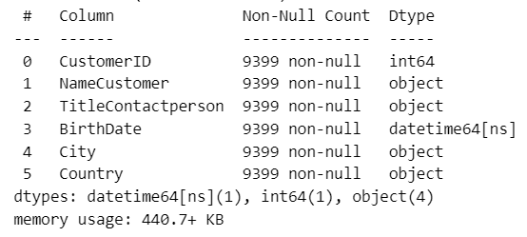
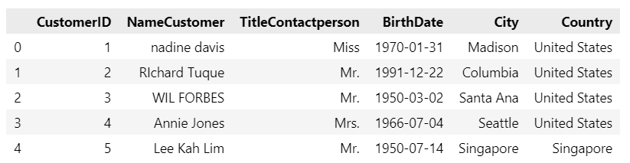
Pandas Import Excel File
!pip install openpyxl
import pandas as pd import os
# use absolute OneLake path for Excel files! path = "abfss://42ce…5124e9@onelake.dfs.fabric.microsoft.com/8c1af…072/Files/Customers.xlsx"
# load xlsx file into DataFrame dfCustomer = pd.read_excel(path)
dfCustomer.info() display( dfCustomer.head(5))

Slide 35
Pandas Import Excel file from SharePoint Online
!pip install Office365-REST-Python-Client
from office365.runtime.auth.user_credential import UserCredential from office365.sharepoint.client_context import ClientContext from io import BytesIO import pandas as pd import requests
def getExcelSheetFromSharePoint(site_url, file_url ): # Authenticate with SharePoint ctx = ClientContext(site_url).with_credentials(\ UserCredential("poweruser@arthurgraus.nl", "P@ssw0rd"))
# Get the file info from SharePoint file = ctx.web.get_file_by_server_relative_url(file_url) # Get the file content from SharePoint file_stream = file.open_binary_stream() ctx.execute_query() file_content = file_stream.value excel_file = BytesIO(file_content)
return excel_file site_url = https://arthurgraus.sharepoint.com/sites/xtreme file_url = "/SalesDataLibrary/Customers.xlsx" excel_file = getExcelSheetFromSharePoint(site_url, file_url )
df = pd.read_excel(excel_file, sheet_name="Customers", engine='openpyxl')

Slide 36
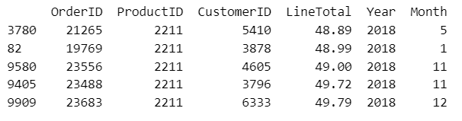
Pandas Transformations: Calculated Columns, Filtering + Sorting
# load csv file into DataFrame dfOrders = pd.read_csv( '...Orders.csv',encoding='utf-8',sep=';')
# Calculated Columns dfOrders['LineTotal'] = dfOrders['Quantity'] * dfOrders['Price'] dfOrders['Year'] = dfOrders['OrderDate'].dt.year dfOrders['Month'] = dfOrders['OrderDate'].dt.month
# Select columns dfOrdersSel = dfOrders[['OrderID','ProductID','CustomerID','LineTotal', 'Year', 'Month']]
# Filter dfOrdersFilt=dfOrdersSel[ (dfOrdersSel['Year']==2018) & (dfOrdersSel['ProductID']==2211) ]
# Sort dfOrdersOrdered = dfOrdersFilt.sort_values(by=['LineTotal'], ascending=[True])
Pandas - DataFrame Reference (w3schools.com)

Slide 37
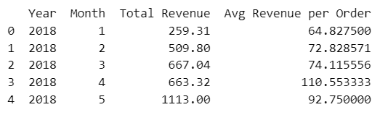
Pandas Transformations: Grouping
# Group data # Agg Functions: sum, mean, min, max, count, nunique, std, var, median, first, last dfGrouped = dfOrdersOrdered \ .groupby(['Year', 'Month']) \ .agg({ 'LineTotal':'sum', 'OrderID':'nunique' }).reset_index()
# Add / rename columns dfGrouped = dfGrouped.rename(columns={ 'LineTotal': 'Total Revenue', 'OrderID': '# of orders' })
dfGrouped['Avg Revenue per Order'] = dfGrouped['Total Revenue'] / dfGrouped['# of orders']
# Drop columns dfOrdersGrouped.drop('# of orders', axis=1, inplace=True)
print(dfOrdersGrouped.head(5))

Slide 38
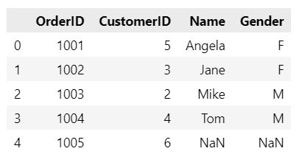
Pandas Transformations: Merge
import pandas as pd
dfOrders = pd.DataFrame( { 'OrderID': [1001, 1002, 1003, 1004, 1005], 'CustomerID': [5, 3, 2, 4, 6] } ) dfCustomers = pd.DataFrame( { 'CustomerID': [1, 2,3 ,4 ,5], 'Name': ['John', 'Mike','Jane', 'Tom', 'Angela'], 'Gender': ['M','M','F','M','F'], } ) dfMerged = pd.merge(left=dfOrders, right=dfCustomers,on= 'CustomerID', how='left')
display( dfMerged )
Jointypes
left: left outer join
right: right outer join
outer: full outer join
inner: inner join
cross: cartesian product

Slide 39
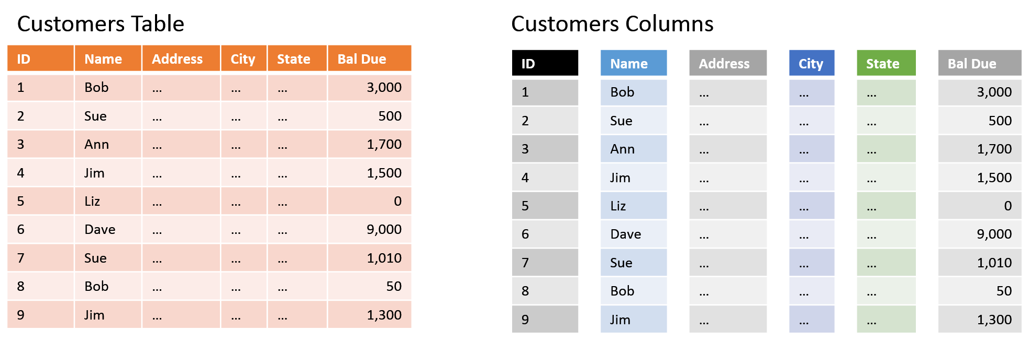
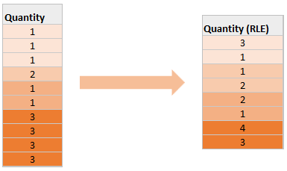
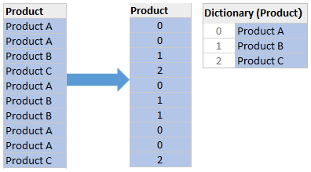
Parquet files: Columnar Storage
Dictionary Encoding
Run Length Encoding

Slide 40
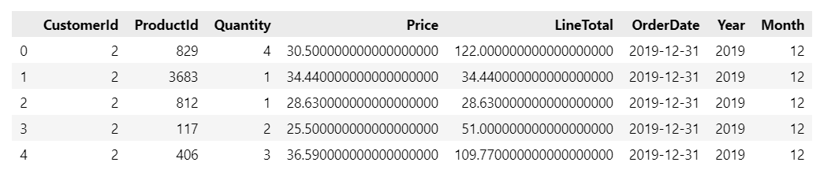
Pandas Import Parquet Files
# pip install pandas import pandas as pd import os
#get current directory current_file_path = os.getcwd()
# Relative OneLake Path dfSales = pd.read_parquet("/lakehouse/default/Files/sales-parquet/…/sale-20191231-snappy.parquet")
dfSales = dfSales[[ 'CustomerId', 'ProductId', 'Quantity', 'Price', 'TransactionDate']] dfSales['LineTotal'] = dfSales['Quantity'] * dfSales['Price'] dfSales['OrderDate'] = pd.to_datetime(dfSales['TransactionDate'], format='%Y%m%d') dfSales['Year'] = dfSales['OrderDate'].dt.year dfSales['Month'] = dfSales['OrderDate'].dt.month
dfSales.drop('TransactionDate', axis=1, inplace=True)
print(dfSales.head(5))

Slide 41
Pandas Import Folder with Parquet files
import pandas as pd
# Define the path to the directory containing the Parquet files file_path = "Files/salestargets-parquet"
# List all the files in the folder files = mssparkutils.fs.ls(file_path)
# Initialize an empty list to store individual DataFrames dfs = []
# Loop through the list of files and read each one into a DataFrame for file in files:
df = pd.read_parquet(file.path)
dfs.append(df)
# Concatenate all the individual DataFrames into one DataFrame dfAllSalesTargets = pd.concat(dfs, ignore_index=True)

Slide 42
Pandas save to OneLake
Save to Parquet
destinationFileUrl = 'Files/Staging/SalesTargets.parquet'
dfAllSalesTargets.to_parquet(destinationFileUrl)
Save to CSV
destinationFileUrl = 'Files/Staging/SalesTargets.csv'
dfAllSalesTargets.to_csv(destinationFileUrl, header=True, encoding='utf-8',sep=';')

Slide 43
Lakehouse + PySpark

Slide 44
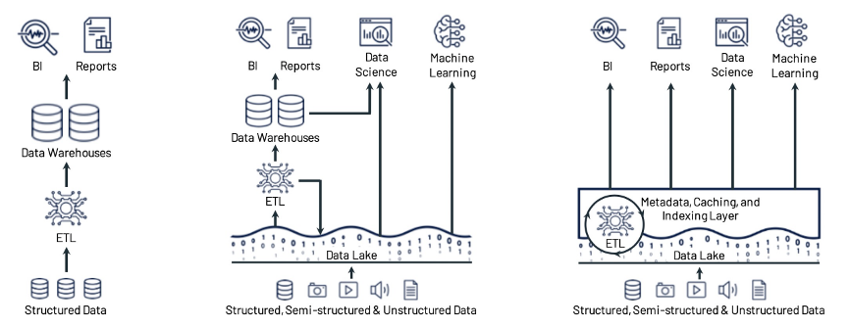


Big Data Architecture: Data Warehouse
Traditional BI Architecture
Pro's
Well known architecture
Works good for structured enterprese data like Sales, Finance, HR, Production
Con's
The scale-out extension capability is poor.
Expensive for large data volumes
Not suitable for high-level and complex query and analysis scenarios, such as data science and ML scenarios.
Use Case
BI
Reporting
Technologies
Azure SQL Parallel DW
Azure Synapse Dedicated SQL

Slide 45



Big Data Architecture: Data Lake
Modern file and folder based architecture
Data is stored in CSV or Parquet format
Pro's
Good for storing (semi) unstructured data, highly scalable
Query lots of files using SQL language (Serverless)
Low-cost storage
Con's
Data redundancy brings greater storage overhead
More complex ETL, extra layers
Use cases
Machine Learning
Data Science
Technologies
Azure Synapse SQL Serverless Pools
Azure Synapse Spark Clusters
Azure Data Lake Storage Gen 2

Slide 46

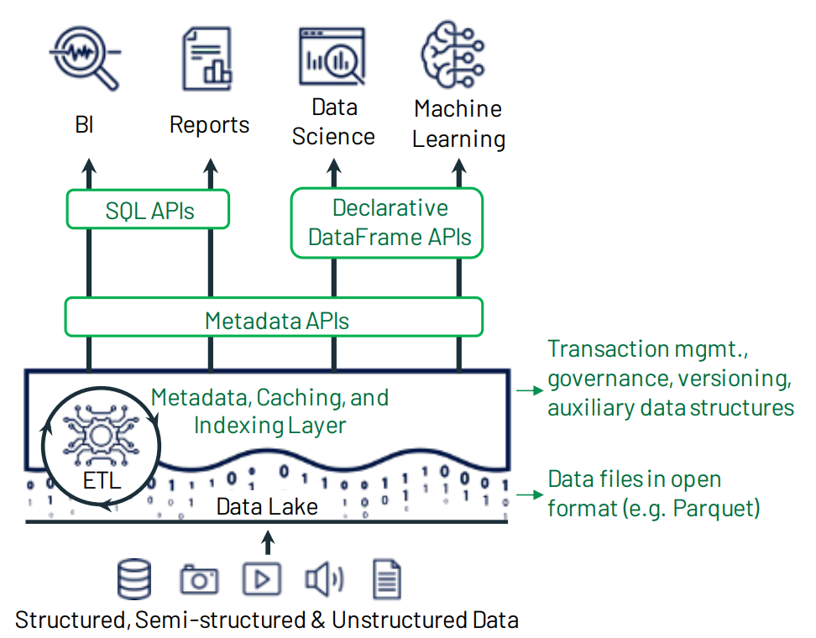



Big Data Architecture: Lakehouse
Lakehouse:
Adds intermediate metadata management layer provides reliable atomicity, consistency, isolation, and durability (ACID) transactions while providing performance optimization for database operations.
Supports data types of all structures and various analysis scenarios.
Technologies:
Databricks
Delta Lake
Microsoft Fabric
SQL End Point
Apache Spark
Delta Lake
Delta Format (Parquet + Transaction Log)
OneLake
Lakehouse: A New Generation of Open Platforms that Unify Data Warehousing and Advanced Analytics (databricks.com)

Slide 47
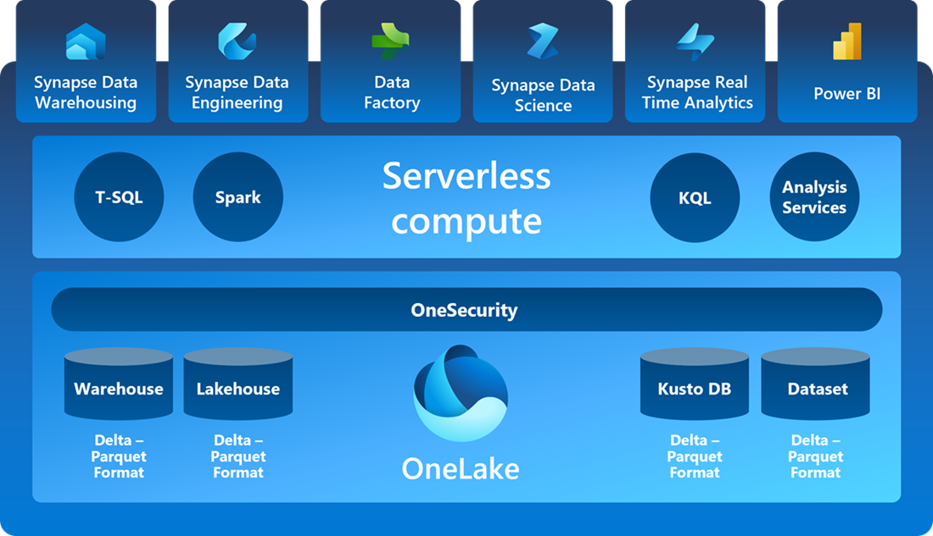

Microsoft Fabric 2023+

Slide 48
Apache Spark
WHEN
Introduced in 2009 in the UC Berkeley R&D Lab
Open sourced in 2010 under BSD license
2013 Spark was donated to Apache Software Foundation
WHAT
General-purpose & lightning fast distributed cluster computing system.
100 times faster than Bigdata Hadoop and 10 times faster than accessing data from disk.
Written in Scala but provides rich APIs in Scala, Java, Python, and R.
It can be integrated with Hadoop and can process existing Hadoop HDFS data.
WHY
Powerful open-source engine that provides very fast speed, ease of use and standard interface for:
real-time stream processing
interactive processing
graph processing
in-memory processing
batch processing
What is Spark - Apache Spark Tutorial for Beginners - DataFlair (data-flair.training)

Slide 49
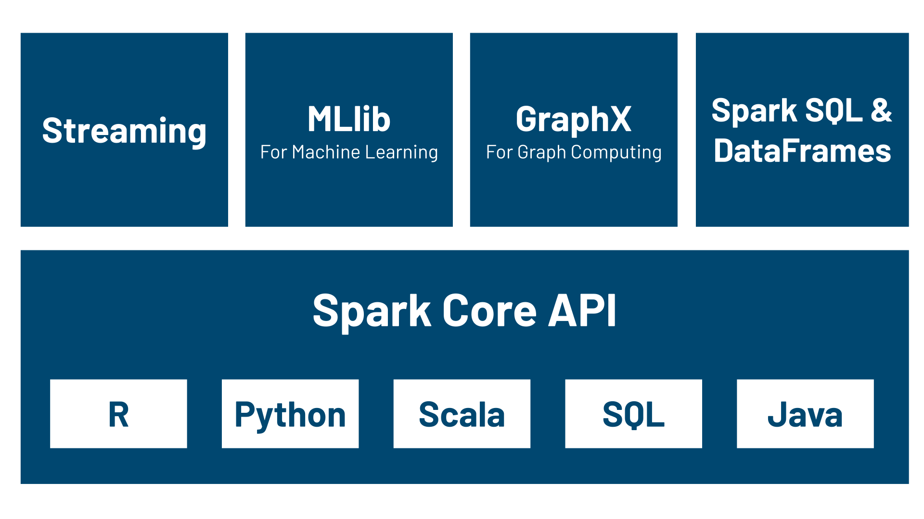
Apache Spark

Slide 50
PySpark DataFrame Basics 1/2
from pyspark.sql.types import StructType, StructField, IntegerType, StringType, DateType, DoubleType
from datetime import date # Define schema explicitly schema = StructType([ StructField("OrderID", IntegerType()), StructField("CustomerID", IntegerType()), StructField("OrderDate", DateType()), StructField("ShipDate", DateType()), StructField("CustomerName", StringType()), StructField("ProductID", IntegerType()), StructField("Qty", IntegerType()), StructField("Price", DoubleType()) ])
# Create Spark DataFrame with schema df = spark.createDataFrame([ (1001, 5, date(2023, 3, 2), date(2023, 3, 6), 'John Johnson', 101, 1, 2.15), (1002, 3, date(2023, 3, 15), date(2023, 3, 16), 'Mike Dawson', 202, 2, 2.59), (1003, 2, date(2023, 3, 30), date(2023, 4, 1), 'Jane Irish', 203, 1, 4.08), (1004, 4, date(2023, 4, 2), date(2023, 4, 6), 'Tom Clansy', 404, 4, 1.55), (1005, 6, date(2023, 4, 11), date(2023, 4, 15), 'Angela O''Reily', 606, 10, 3.54)
], schema=schema)

Slide 51
PySpark Dataframe Basics 2/2
import pyspark.sql.functions as f # https://spark.apache.org/docs/latest/api/python/reference/pyspark.sql/functions.html
# Using Vectorized Operations to create Calculated Columns
df = df.withColumn("LineTotal", df["Qty"] * df["Price"])
df = df.withColumn("LineTotal", f.ceil(df["LineTotal"]))
df = df.withColumn("Year", f.year(df["OrderDate"]))
df = df.withColumn("LeadTime", f.datediff(df["ShipDate"], df["OrderDate"]))
df = df.withColumn("Lower", f.lower(df["CustomerName"]))
df = df.withColumn("FirstUpper",f.upper( f.substring(df["CustomerName"], 1, 1) ) )
df = df.withColumn("FN",f.substring(df["CustomerName"],1,f.instr(df["CustomerName"],' ')-1))
# Using Spark SQL expressions to create more complex Calculated Columns df = df.withColumn("FN", f.expr("substring(CustomerName, 1, instr(CustomerName, ' ') - 1)"))
# Show the df df.show()

Slide 52
PySpark Import CSV file(s) into DataFrame
import pyspark.sql.functions as f
#Absolute abfs Path pathContainer = 'abfss://a366343…a3c@onelake.dfs.fabric.microsoft.com/03894de…44161b0e7'
pathFile = pathContainer + '/Files/Orders.csv'
#Relative path pathFile = 'Files/Orders.csv'
#Whole folder pathFile = 'Files/*.csv'
## Read CSV File(s) df = spark.read.load(pathFile, format='csv', header=True,sep=";", inferSchema=True)
df = df.withColumn("OrderDate", f.to_date(df['OrderDate'], "MM/dd/yyyy")) df = df.withColumn("Price", f.regexp_replace(df["Price"], ",", "").cast("double")) df = df.withColumn("LineTotal", f.round( df["Price"] * df["Quantity"] ,2))
## SELECT top 5 display(df.schema) df.limit(5).show()

Slide 53
PySpark Import Parquet file(s) into DataFrame
#Relative path folder
pathFile ='Files/sales-parquet/*/*/*/*/*.parquet'
df = spark.read.load(pathFile, format='parquet')
#Recursive
pathFile = 'Files/sales-parquet/'
df = spark.read.option("recursiveFileLookup","true").load(pathFile, format='parquet')
## SELECT top 5
display(df.schema)
df.limit(5).show()

Slide 54
PySpark DataFrame Transformations: Calculated Columns
import pyspark.sql.functions as f
pathFile = 'Files/Orders.csv'
## Read CSV File
df = spark.read.load(pathFile, format='csv', header=True,sep=";", inferSchema=True)
#Add Calculated Columns
df = df.withColumn("OrderDate", f.to_date(df["OrderDate"], 'MM/dd/yyyy'))
df = df.withColumn("Price", f.regexp_replace(df["Price"], ",", "").cast("double"))
df = df.withColumn("LineTotal", f.round( df["Price"] * df["Quantity"] ,2))
df = df.withColumn("Year", f.year( df["OrderDate"]) )
df = df.withColumn("Month", f.month( df["OrderDate"]) )
df.printSchema()

Slide 55
PySpark DataFrame Transformations: Filter + Group BY
# Filter rows df_filtered = df.filter( (df["Year"] == 2018) & (df["ProductID"] == 3303))
df_filtered = df.where( "Year= 2018 and ProductID= 3303")
# Group rows df_grouped = df_filtered.groupBy("Year", "Month") \ .agg( f.sum("LineTotal").alias("Total Revenue"), f.countDistinct("OrderID").alias("# of orders") )
# Calculated Columns df_grouped = df_grouped.withColumn( "Avg Revenue per Order", f.col("Total Revenue") / f.col("# of orders") )
display( df_grouped # Select Columns .select("Year", "Month","Total Revenue", "Avg Revenue per Order")
# Sort rows .sort("Year" ,"Month")
)

Slide 56
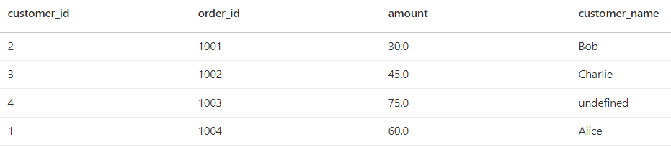
PySpark DataFrame Transformations: Join
orders_data = [ (1001, 2, 30.0), (1002, 3, 45.0), (1003, 4, 75.0), # This order has no corresponding customer (1004, 1, 120.0) ] orders_columns = ["order_id", "customer_id", "amount"] orders_df = spark.createDataFrame(orders_data, orders_columns)
customers_data = [ (1, "Alice"), (2, "Bob"), (3, "Charlie") ] customers_columns = ["customer_id", "customer_name"] customers_df = spark.createDataFrame(customers_data, customers_columns)
# Left Join DataFrames on customer_id left_joined_df = orders_df.join(customers_df, "customer_id", how="left")
Jointypes
left: left outer join
right: right outer join
outer: full outer join
inner: inner join
cross: cartesian product

Slide 57
Insert Data into Lakehouse
Files:
# Save Dataframe as CSV file: df.write.mode("overwrite").format("csv").save("Files/Raw/AllOrders.csv ")
# Save Dataframe as Parquet file: df.write.mode("overwrite").format("parquet").save("Files/Raw/AllOrders.parquet")
Tables:
# Save as Parquet Table df.write.mode("overwrite").format("parquet").saveAsTable('orders_parquet')
# Save as Delta Table df.write.mode("overwrite").format("delta").saveAsTable('orders_delta')
# overwrite == delete table if exits # append == add rows to existing table

Slide 58
Query Table using Spark SQL
%%sql
SELECT YEAR(O.OrderDate), SUM(O.LineTotal) AS TotalRevenue FROM orders_parquet O GROUP BY YEAR(O.OrderDate) ORDER BY YEAR(O.OrderDate)
%%pyspark
sql = """ SELECT YEAR(O.OrderDate), SUM(O.LineTotal) AS TotalRevenue FROM orders_parquet O GROUP BY YEAR(O.OrderDate) ORDER BY YEAR(O.OrderDate)
"""
df = spark.sql(sql)
Spark SQL Documentation

Slide 59
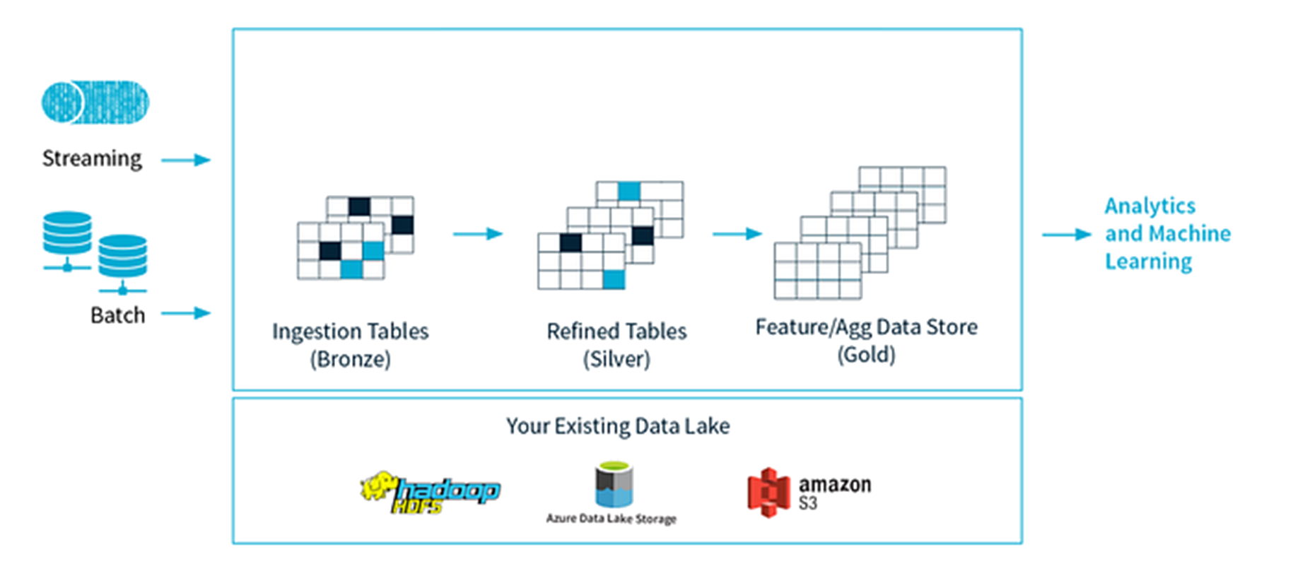




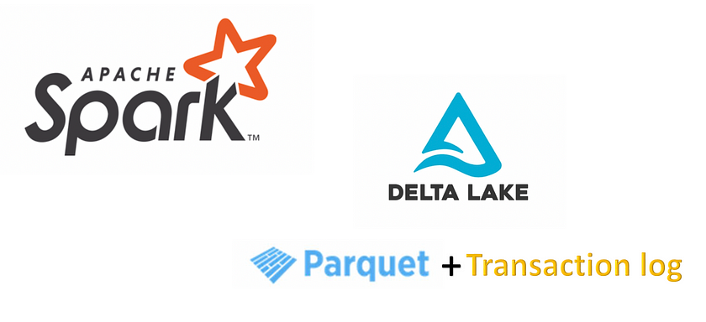
MS Fabric + Delta Lake + Medallion Architecture
Parquet files (raw)
Delta Tables (clean)
Delta Tables (Star schema)
=
Delta Lake Cheatsheet (databricks.com)

Slide 60
PySpark Import SQL Server data into DataFrame
from pyspark.sql import SparkSession database_name = "Xtreme2022" query = """ ( SELECT O.* FROM Data.Orders AS O ) as Qry"""
database_user = "poweruser" database_password = "P@ssw0rd" database_url = "jdbc:sqlserver://uaptdderwp.database.windows.net:1433;databaseName=" + database_name
# Reading data from SQL Server df = spark.read \ .format("jdbc") \ .option("url", database_url) \ .option("dbtable", query) \ .option("user", database_user) \ .option("password", database_password) \ .option("driver", "com.microsoft.sqlserver.jdbc.SQLServerDriver") \ .load()

Slide 61
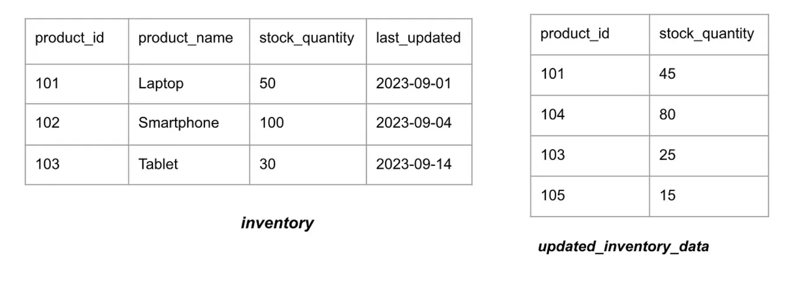
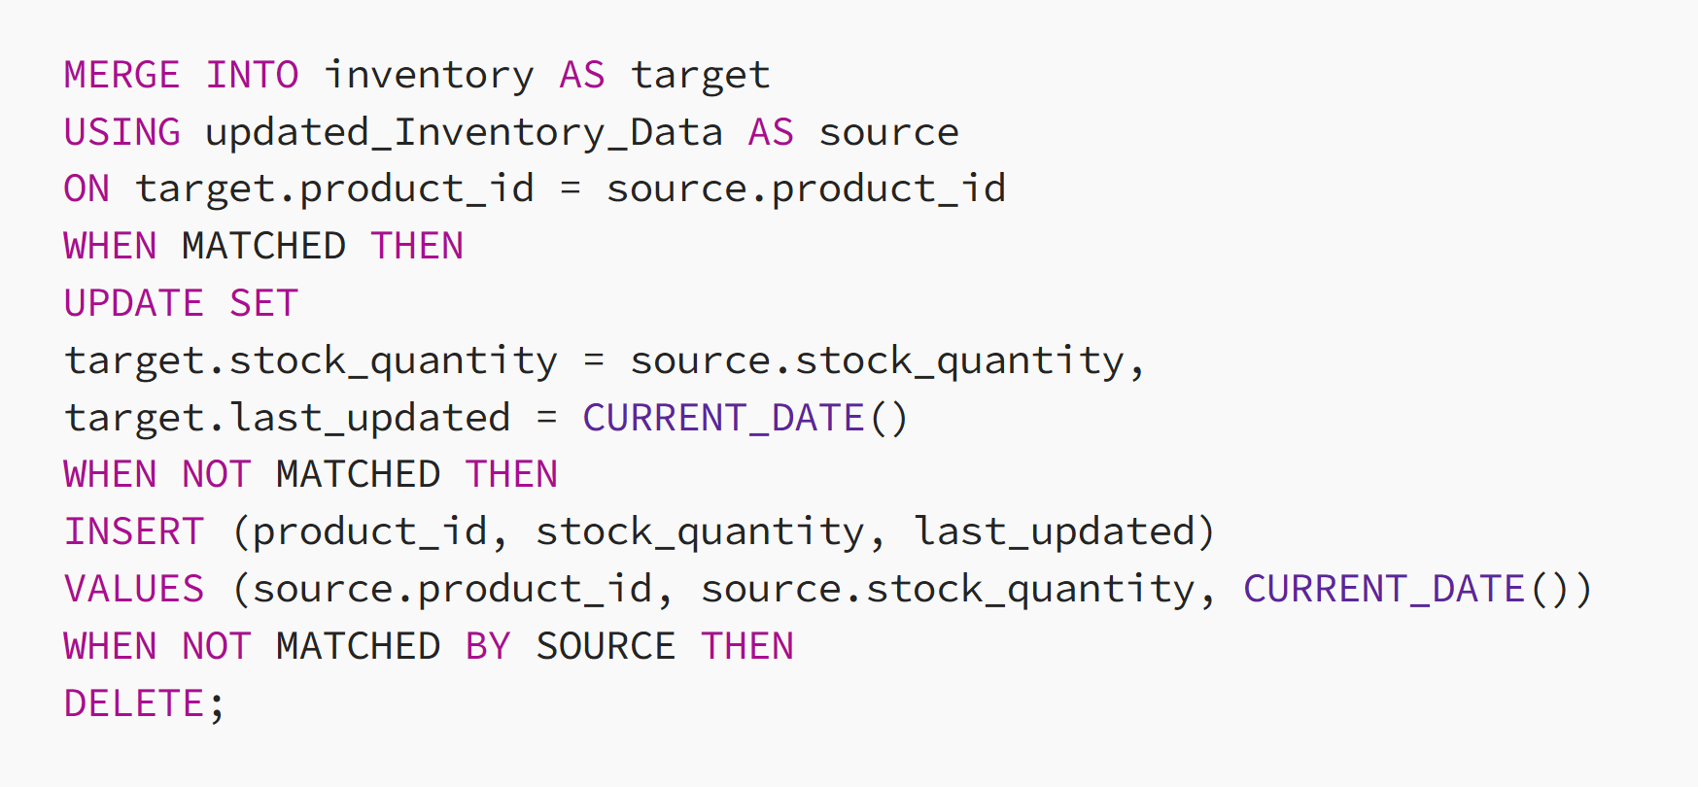
Upsert with MERGE Statement
Update Delta Tables using MERGE in Spark | by Pallavi Sinha | Medium

Slide 62
Bonus: Calling REST API's

Slide 63




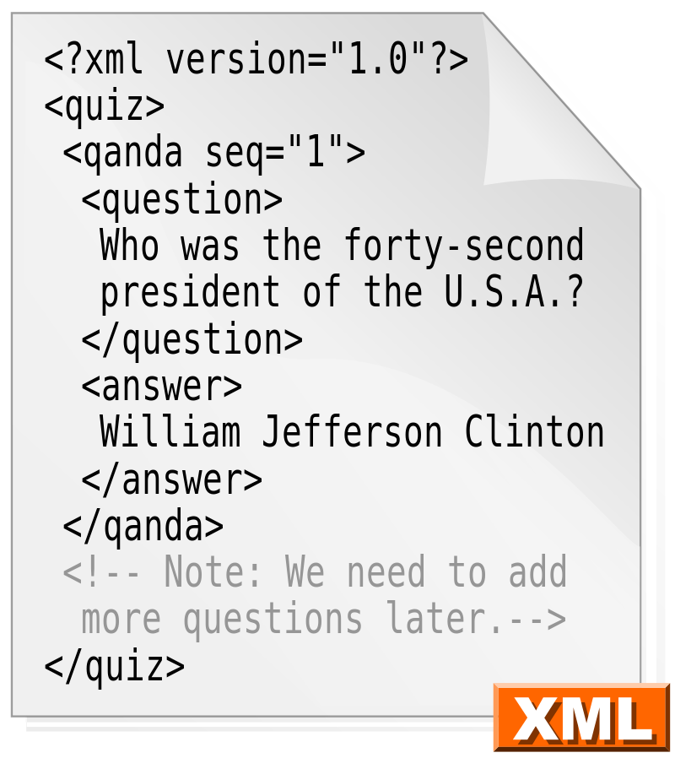
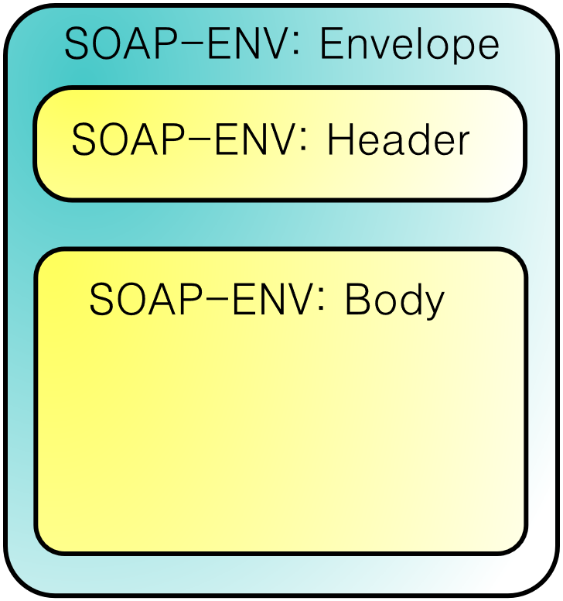


Web API (Application Programmers Interface)
API KEY

Slide 64
HTTP (Hyper Tekst Transfer Protocol) REQUEST
Method: GET, POST, PUT, PATCH, DELETE
URL:
Protocol:
GET http://ergast.com/api/f1/2021 HTTP/1.1
Accept: application/xml , */*
User-Agent: Microsoft.Data.Mashup
Accept-Encoding: gzip, deflate
Host: ergast.com
Connection: Keep-Alive
Accept MIME Type: text/html application/xml application/json
Client: IE, Chrome, Edge Power Query
Postman | The Collaboration Platform for API Development

Slide 65
HTTP RESPONSE
Status code
RESPONSE
HTTP/1.1 200 OK
Date: Thu, 23 Sep 2021 12:56:49 GMT
Server: Apache/2.4.6 (CentOS) OpenSSL/1.0.2k-fips PHP/5.4.16
X-Powered-By: PHP/5.4.16
Access-Control-Allow-Origin: *
Keep-Alive: timeout=5, max=100
Connection: Keep-Alive
Transfer-Encoding: chunked
Content-Type: application/xml; charset=utf-8
<?xml version="1.0" encoding="utf-8"?>
<?xml-stylesheet type="text/xsl" href="/schemas/mrd-1.4.xsl"?>
<MRData xmlns="http://ergast.com/mrd/1.4" series="f1" url="http://ergast.com/api/f1/2021" limit="30" offset="0" total="22">
<RaceTable season="2021">
<Race season="2021" round="1" url="https://en.wikipedia.org/wiki/2021_Bahrain_Grand_Prix">
<RaceName>Bahrain Grand Prix</RaceName>
<Circuit circuitId="bahrain" url="http://en.wikipedia.org/wiki/Bahrain_International_Circuit">
<CircuitName>Bahrain International Circuit</CircuitName>
<Location lat="26.0325" long="50.5106">
<Locality>Sakhir</Locality>
Server
Content-Type MIME type: text/html application/xml application/json
Body

Slide 66
HTTP Status codes (Response)
100+: Mededelend
100: Doorgaan
101: Protocollen worden verwisseld
200+: Goed gevolg
200: OK
201: Aangemaakt
202: Aanvaard
203: Niet-gemachtigde informatie
…
300+: Omleiding
300: Meerkeuze
301: Definitief verplaatst
302: Tijdelijk verplaatst
303: Zie andere
304: Niet gewijzigd
307: Tijdelijke omleiding
400+: Aanvraagfout
400: Foute aanvraag
401: Onvoldoende toegangsrechten
402: Betalende toegang
403: Verboden toegang
404: Niet gevonden
405: Methode niet toegestaan
406: Niet aanvaardbaar
407: Verificatie op de proxyserver verplicht
408: Aanvraagtijd verstreken
409: Conflict
410: Verdwenen
411: Lengte benodigd
412: Niet voldaan aan vooraf gestelde voorwaarde
413: Aanvraag te groot
414: Aanvraag-URL te lang
415: Media-type niet ondersteund
416: Aangevraagd gedeelte niet opvraagbaar
500+: Serverfout
500: Interne server fout
501: Niet geïmplementeerd
502: Bad Gateway
503: Dienst niet beschikbaar
…

Slide 67
MIME (Multipurpose Internet Mail Extensions) Types:
Text : Humanreadable
text/css: Cascading Style Sheets
text/csv: Comma-separated values
text/html: HTML
text/plain: Textual data
text/xml: Extensible Markup Language
Application: for Web API's and JavaScript
application/atom+xml: Atom feeds (ODATA)
application/json: JavaScript Object Notation JSON
application/javascript: ECMAScript/JavaScript
application/soap+xml: SOAP
application/xml: XML files
Images
image/gif: GIF image
image/jpeg: JPEG JFIF image
image/png: Portable Network Graphics

Slide 68
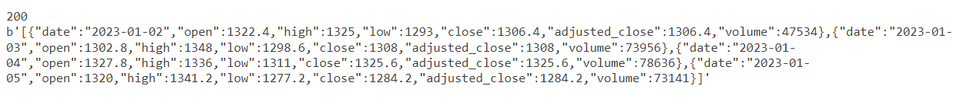
HTTP GET REQUEST
import requests
stockCode ="Adyen" exchangeCode ="AS" APIToken= "60fa9533ac9217…."
queryStringParams = { "api_token": APIToken, "fmt":"json", "period":"d", "from":"2023-01-01", "to":"2023-01-05" }
headers = { "Content-Type":"application/json" }
url = "https://eodhistoricaldata.com/api/eod/" + stockCode + "." + exchangeCode
# Make the GET request
response = requests.get(url, params=queryStringParams, headers=headers)
display(response.status_code)

Slide 69
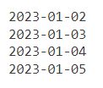
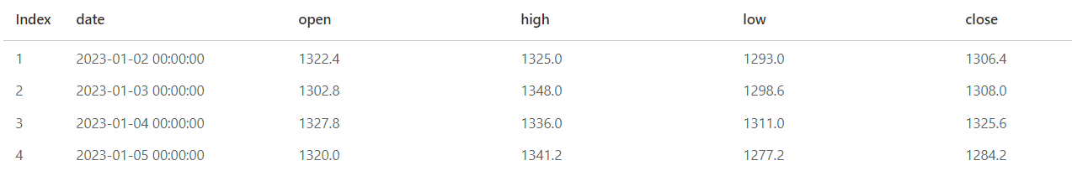
HTTP GET RESPONSE
jsonData= response.json() display(jsonData)
# loop through items in JSON for item in jsonData: print(item['date'])
# load into Pandas Dataframe import pandas as pd from io import StringIO
df = pd.DataFrame(jsonData) df['date'] = pd.to_datetime(df['date'], format='%Y/%m/%d')
# load into PySpark DataFrame df = spark.read.json(spark.sparkContext.parallelize([json_data]))

Slide 70

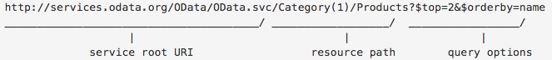
ODATA 1/2
$filter=: Returns only entities that match the specified expression. …/Products/?$filter=CategoryID eq 435
$orderby=: Orders results, in ascending or descending order, by the value of one or more properties in those results. …/Products/?$orderby=Name desc
$select=: Returns only the specified properties in an entity. …/Products?$select=Price,Name
$inlinecount=: Returns the total number of rows that match the $filter criteria. Useful for paging in combination with $top and $skip …/Products?$inlinecount=allpages
$top=n: Returns only the first n entities in an entity set (or in Atom terms, the first n entries in a feed). …/Products/?$top=2
$skip=n: Skips the first n entities in an entity set. Using this option lets a client retrieve a series of distinct pages on subsequent requests. …/Products?$skip=2

Slide 71
ODATA 2/2 $filter operators
Operator |  |  | Example
eq | Equal | /Suppliers?$filter=Address/City eq 'Redmond' | /Suppliers?$filter=Address/City eq 'Redmond'
ne | Not equal | /Suppliers?$filter=Address/City ne 'London' | /Suppliers?$filter=Address/City ne 'London'
gt | Greater than | /Products?$filter=Price gt 20 | /Products?$filter=Price gt 20
ge | Greater than or equal | /Products?$filter=Price ge 10 | /Products?$filter=Price ge 10
lt | Less than | /Products?$filter=Price lt 20 | /Products?$filter=Price lt 20
le | Less than or equal | /Products?$filter=Price le 100 | /Products?$filter=Price le 100
and | Logical and | /Orders?$filter=OrderDate ge datetime'2021-01-01T00:00:00' and OrderDate lt datetime'2021-02-01T00:00:00' | /Orders?$filter=OrderDate ge datetime'2021-01-01T00:00:00' and OrderDate lt datetime'2021-02-01T00:00:00'
or | Logical or | /Products?$filter=Price le 3.5 or Price gt 200 | /Products?$filter=Price le 3.5 or Price gt 200
not | Logical negation | /Products?$filter=not endswith(Description,'milk') | /Products?$filter=not endswith(Description,'milk')

Slide 72
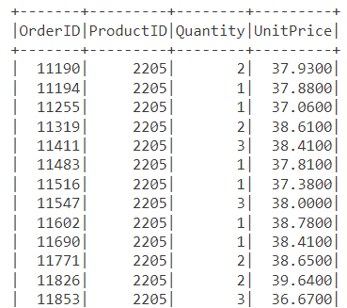
Call ODATA REST API
import requests queryStringParams = { "$top": "50", "$skip":"200", "$filter":"ProductID eq 2205" } headers = { "Content-Type":"application/json" } url = "https://xtremeodatarestapi.azurewebsites.net/odata/OrderLines"
# Make the GET request response = requests.get(url, params=queryStringParams,\ headers=headers)
# Get JSON Data json_data =response.json() data = json_data["value"]
# Create DataFrame from JSON data df = spark.read.json(spark.sparkContext.parallelize([data]))
# Show DataFrame df.show(100)

Slide 73




Thank you!
Download slides, code samples + video:
https://www.arthurgraus.nl/python_fabric_data_engineer
Questions, reach out to me:
info@arthurgraus.nl
https://www.linkedin.com/in/arthurgraus

